Slide 1
Speechalyzer
Felix Burkhardt

Slide 2
Speechalyzer
Speechalyzer is optimized to process large speech data sets with respect to transcription, labeling and annotation.
It is implemented as a client server based framework in Java
Interfaces software for
speech recognition,
synthesis,
speech classification
quality evaluation.

Slide 3
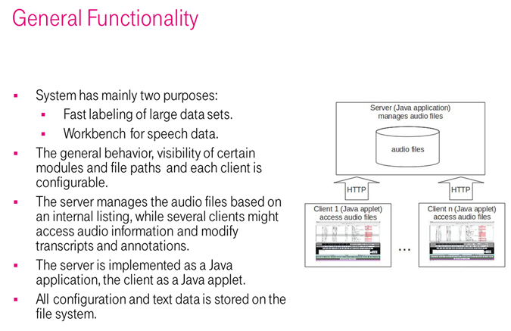
Speechalyzer

Slide 4
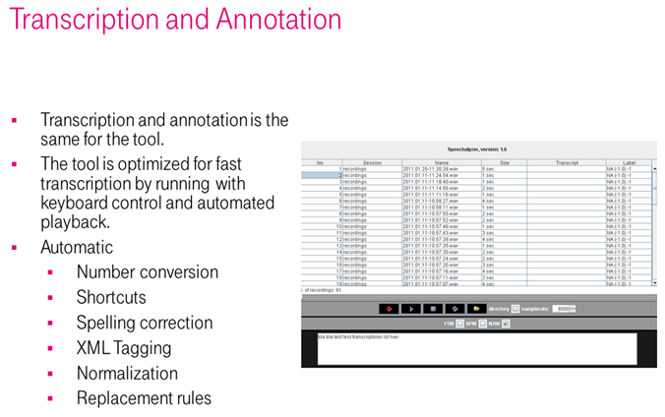
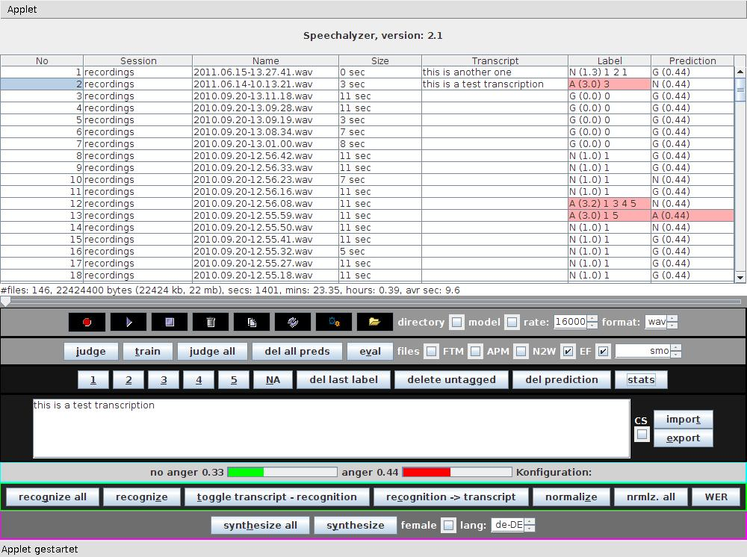
Speechalyzer

Slide 5
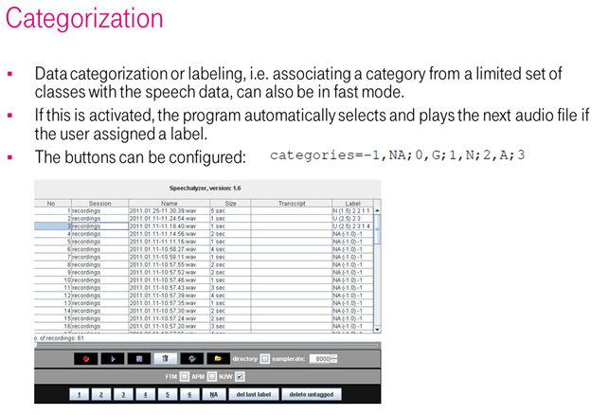
Speechalyzer

Slide 6
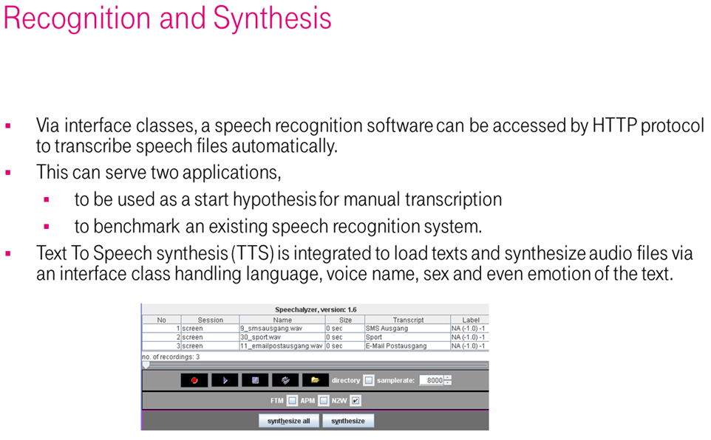
Speechalyzer

Slide 7
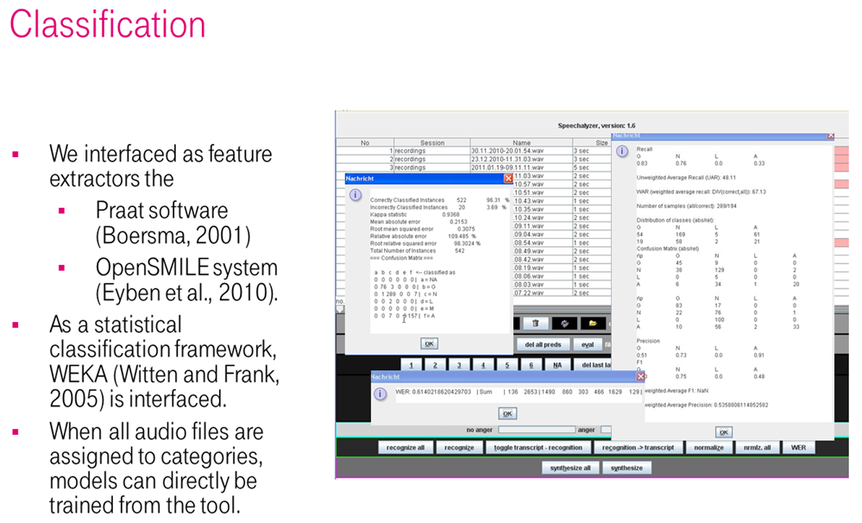
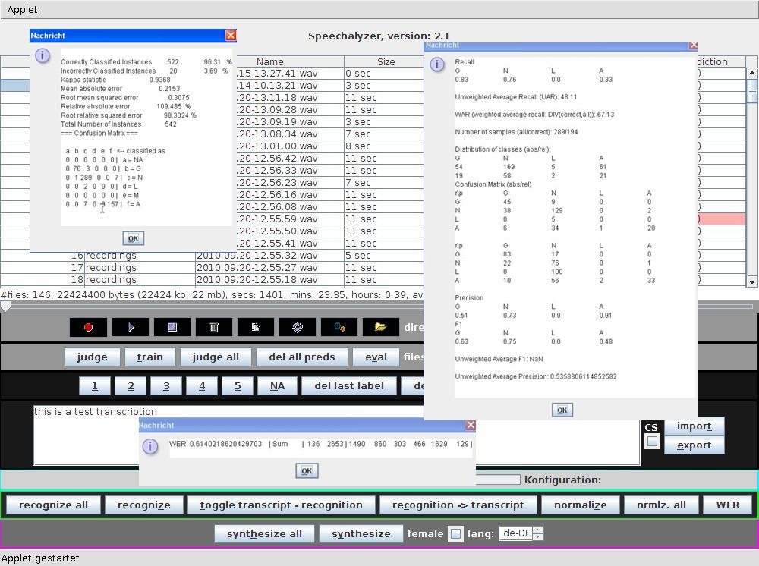
Speechalyzer

Slide 8
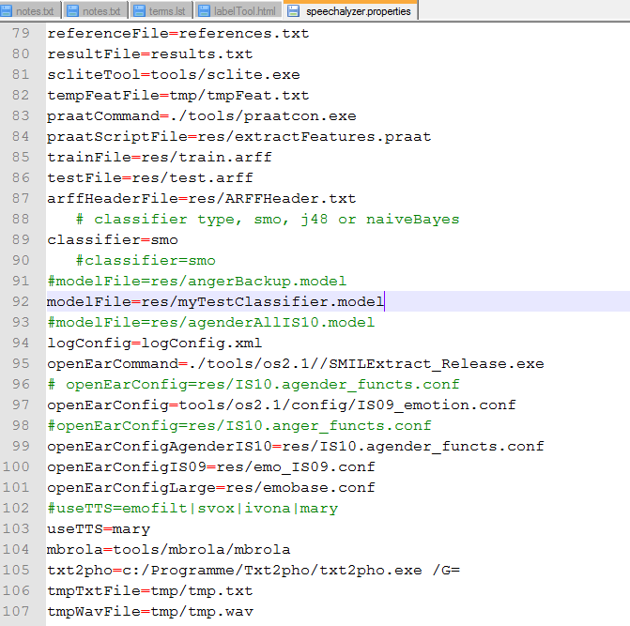
Speechalyzer
Configuration
Speechalyzer
(the server program)
In text file

Slide 9
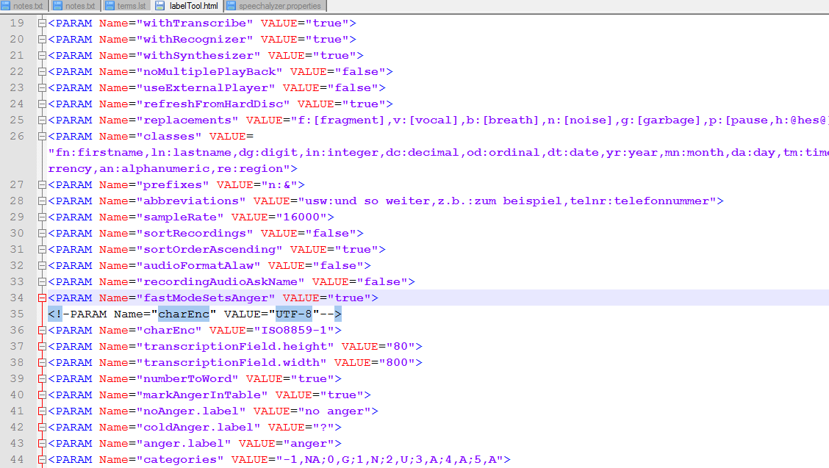
Speechalyzer
Configuration
Labeltool
(the client program and GUI)
as applet
parameters

Slide 10
Speechalyzer
Conclusion:
Speechalyzer is optimized to process large speech data sets with respect to transcription, labeling and annotation.
Contact:
Felix.Burkhardt@telekom.de

